Slide 1

Zühlke Tech 4 Good: Sprint
Tech Returners, Team CodeBenders
March’21 Cohort
Ciaran Cullen, Marius Grigore, Susan Luebke, Sriranjini Srinivasa
April 15, 2021

Slide 2


Ciaran Cullen Previous experience: 2 year accelerated BSc Games Programming course, 8 weeks of C#sdet training and a little work experience in a Telemarketer company Previous Projects: LDAP server syncing, Text based, 2D, 3D and VR games, Testing OpenWeatherMapAPI, Testing websites Tools/Libarys learned: for C++: SDL, SDL_net and Opengl using visual studio 2017 For C#: Unity, Nunit, SpecFlow and Selenium I have done very small projects using ASP.net, XAML and SQL servers. Self learning: Appium (mobile testing) Learning from Tec Returners: Java and JavaScript and much more!

Slide 3
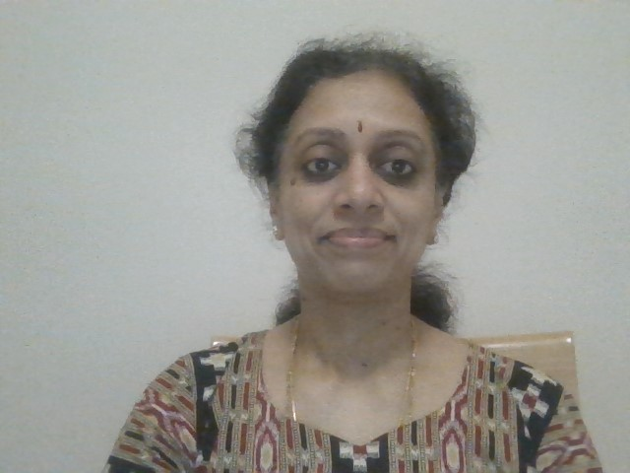
Sriranjini Srinivasa Masters Degree in Computer Applications Around 7 years of work experience as a Techno-Functional Consultant for ERP and RDBMS Fair knowledge of Asp.Net, C#, Java Worked with clients like Woolworths, Acer, Eaton Always open to learn new technologies

Slide 4
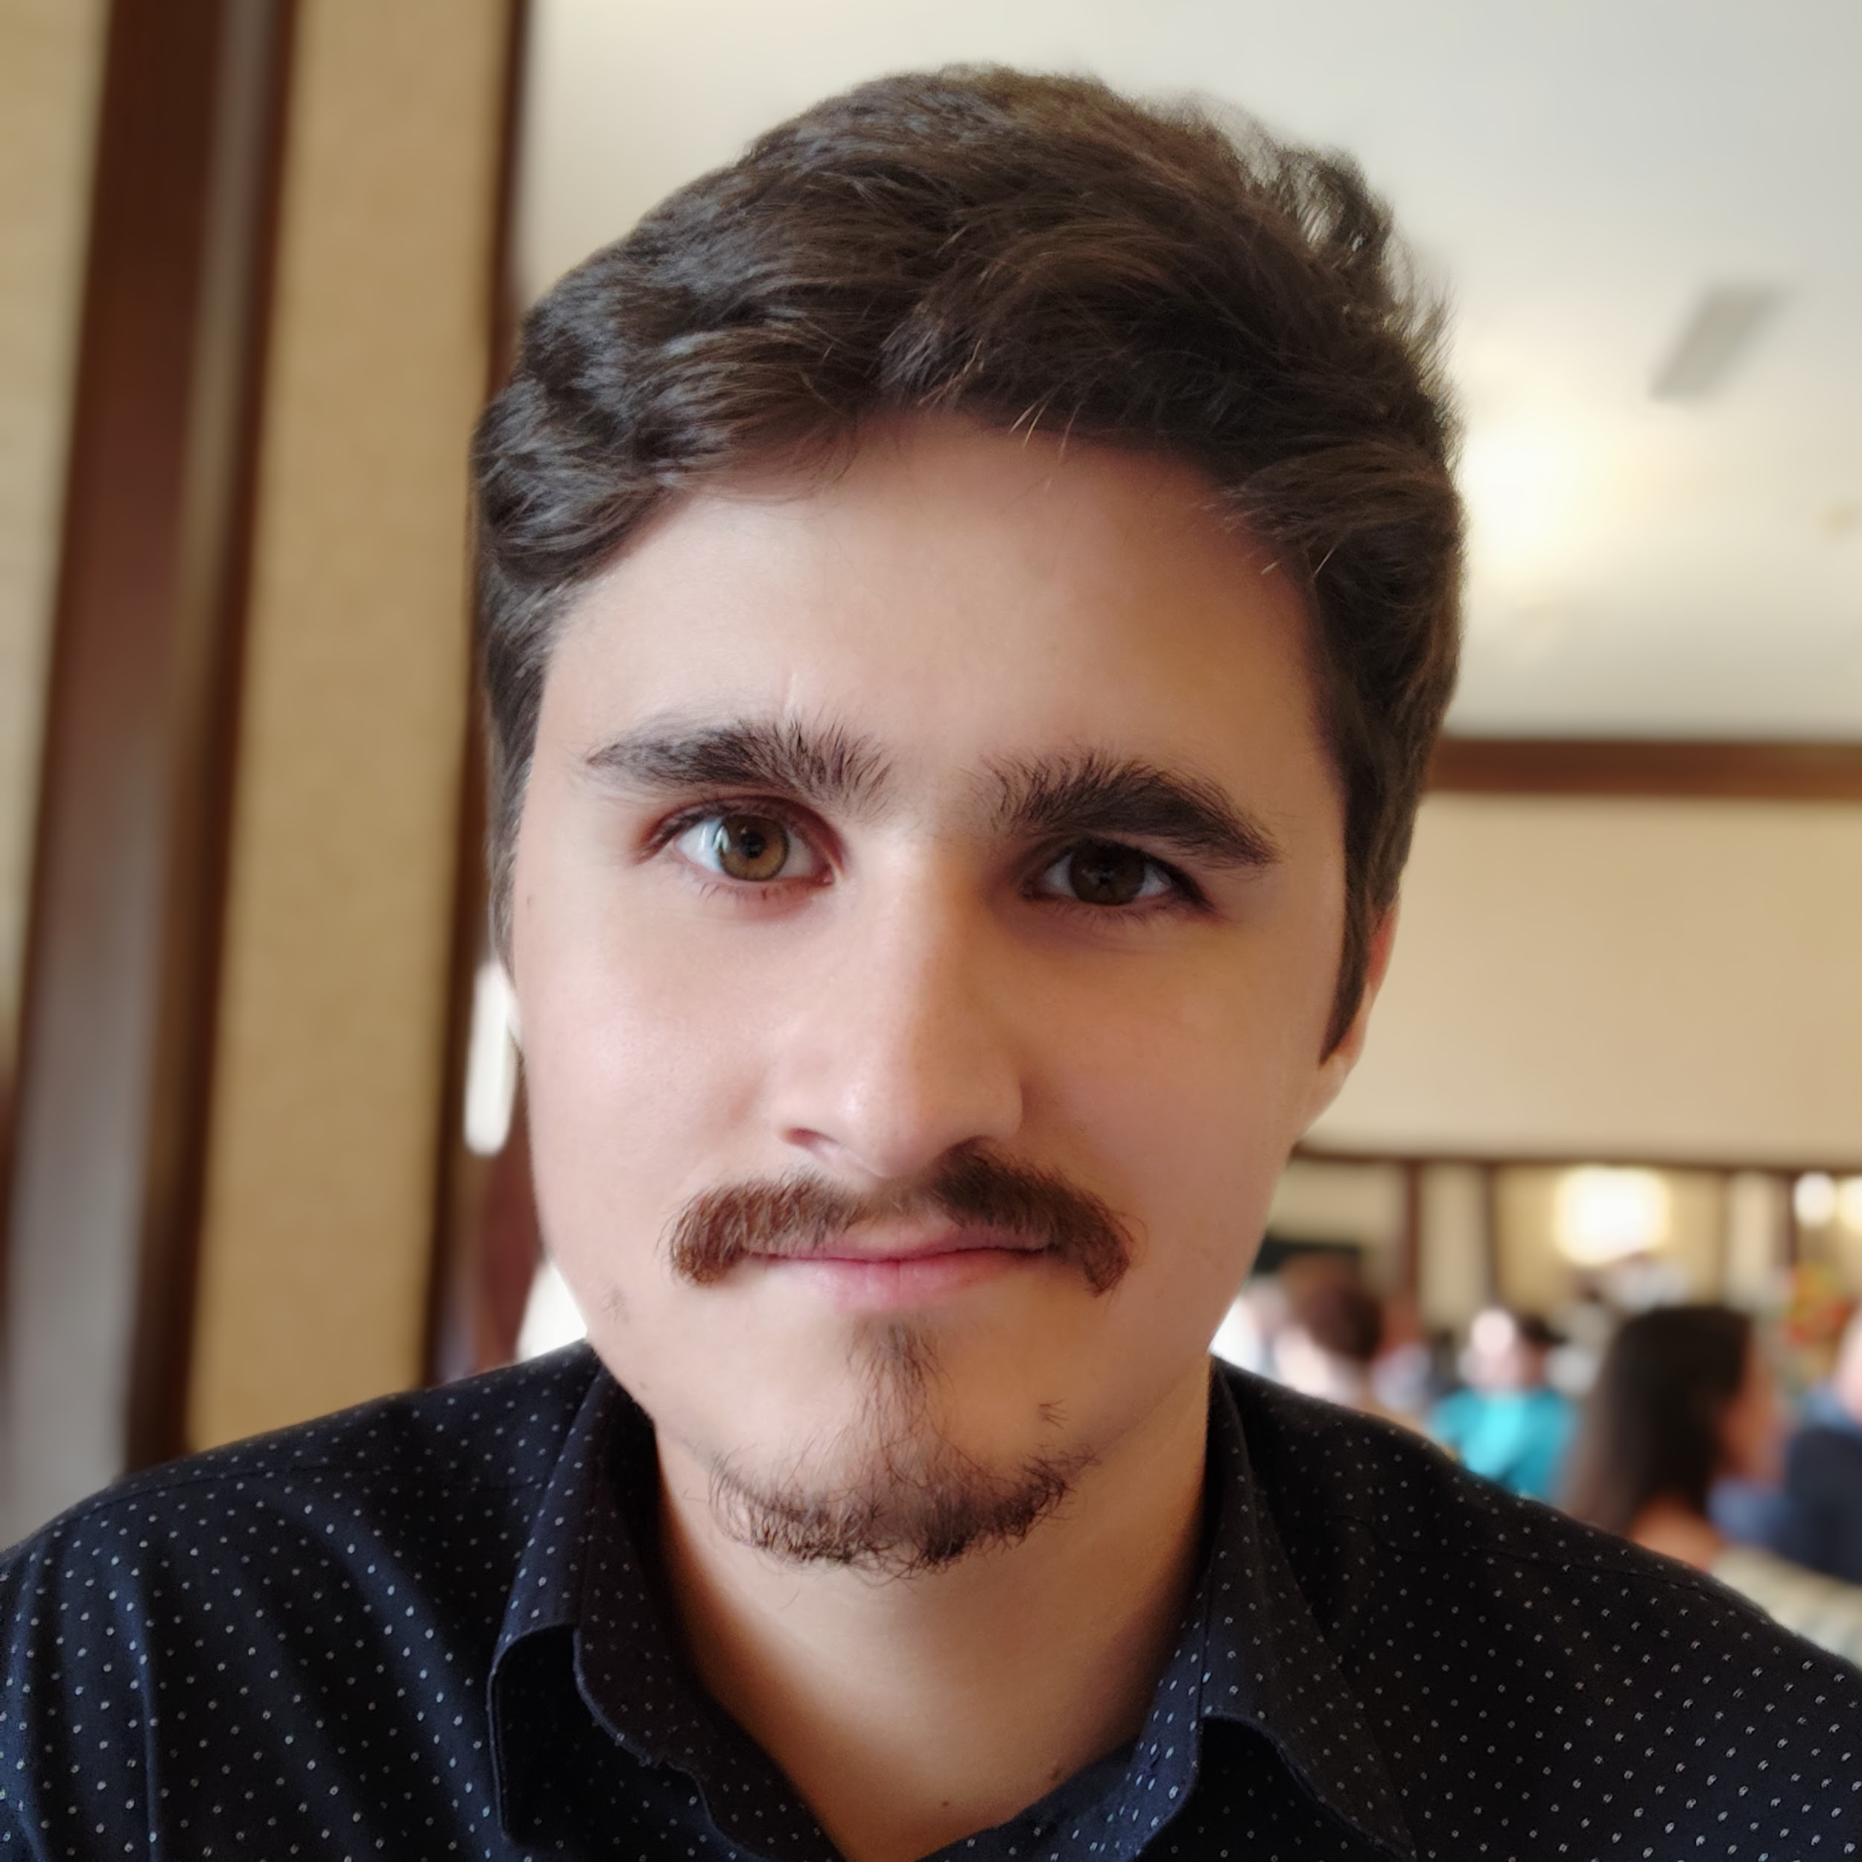
Marius Grigore BSc in Computer Science 4 years of commercial technical experience - Created internal automation tools (Python, Java, Matlab, VB) - Offered technical and process support for a team of 20 people - Worked on engine control projects for Renault and Nissan I have a real interest in everything related to technology

Slide 5
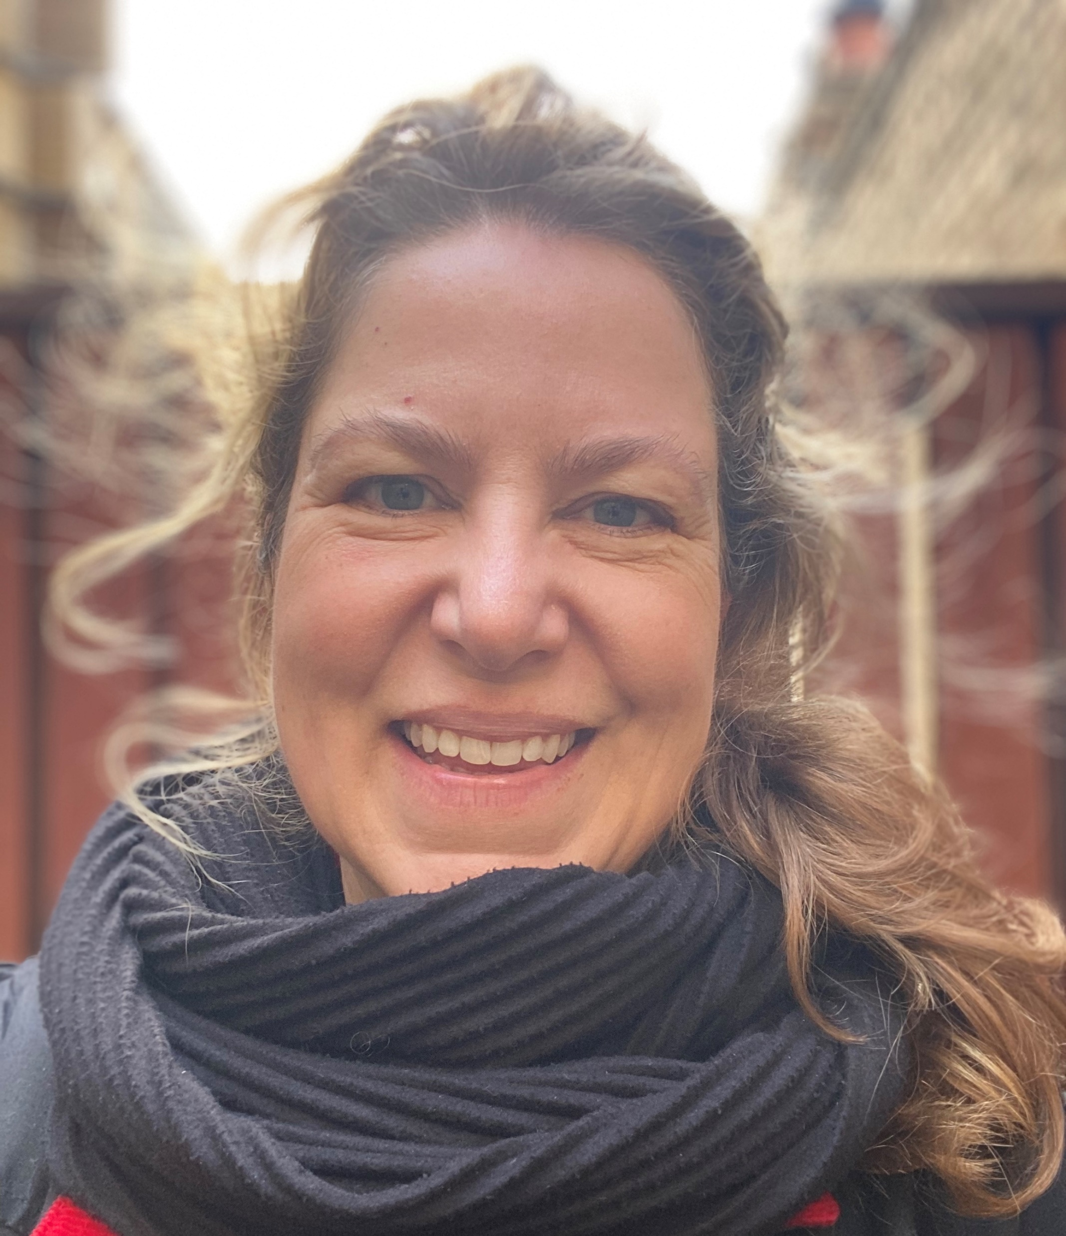
Susan Luebke Hello – my name is Susan. I have an MSW, MBA and 15 years’ experience as an innovative consumer Insights and brand marketing professional with project, agency and stakeholder management expertise with LG, Bacardi, Grace Kennedy, BP and LucasArts, to name a few Experience with Python, SQL, PowerBI and Tableau and I’ve received awards for product design COVID-19 provided me with an opportunity to upskill and pursue a career switch with a greater emphasis on solution-based programming; something I’ve been interested in doing since writing my first iPhone app several years ago

Slide 6
Sunny Walk
Create a web app that can advise the user on the best times to take daily walks in order to maximise intake of sunshine.
Tech 4 Good

Slide 7
Create a web app that can advise the user on what the best times for them to take daily walks would be in order to maximise their intake of sunshine.
Persona – resident of Manchester/London or “walker”
FEATURES | STRETCH FEATURES | STRETCH FEATURES: DIFFERENT TYPES OF USERS | TECHNICAL
During what times I can get the most sunshine based on my location, current time and the weather forecast so I that I can plan my walk into my day and optimize my sunshine intake | Log the area where I walked so that I can track my walks on the map | Walker, customize my user profile so that I can receive relevant advice about/during my walks (e.g. I don’t like rain, so I would like to be advised if I should take an umbrella with me) | Responsive web design
Receive a notification some time before my walk so that I don’t miss it | My preferred locations so that I can plan to enjoy the sunshine in places that I usually frequent or I am about to travel to | Wheelchair user, I want to know about the walks that are accessible (wheelchair friendly) so that I can enjoy the sunshine without worries or assistance | Progressive web app
Log if a walk was good or bad so that I can track my satisfaction with the walks over time | Set up my preferred weather conditions so that I can enjoy my favourite weather during my walks. (e.g. I prefer cloudy weather; I prefer taking walks in the rain) | Dog walker, I want to know routes with dog-friendly areas nearby so that my dog can socialise with other dogs | Accessibility considerations
 |  | Parent, I want to know about routes that have parks with playgrounds nearby so that I can enjoy a walk without my children getting bored. | Possibility of using data from gov.uk (or something else), being Manchester
 |  | Roller skater, I want to know where the safest routes for roller skating are so that I can enjoy my hobby without needing replacement wheels after every outing or injuring myself
 |  | Walker, I want to leave comments about the area where I had a walk so that I can make other users aware about different area features. (e.g. water fountains, dog waste bins, etc.)

Slide 8
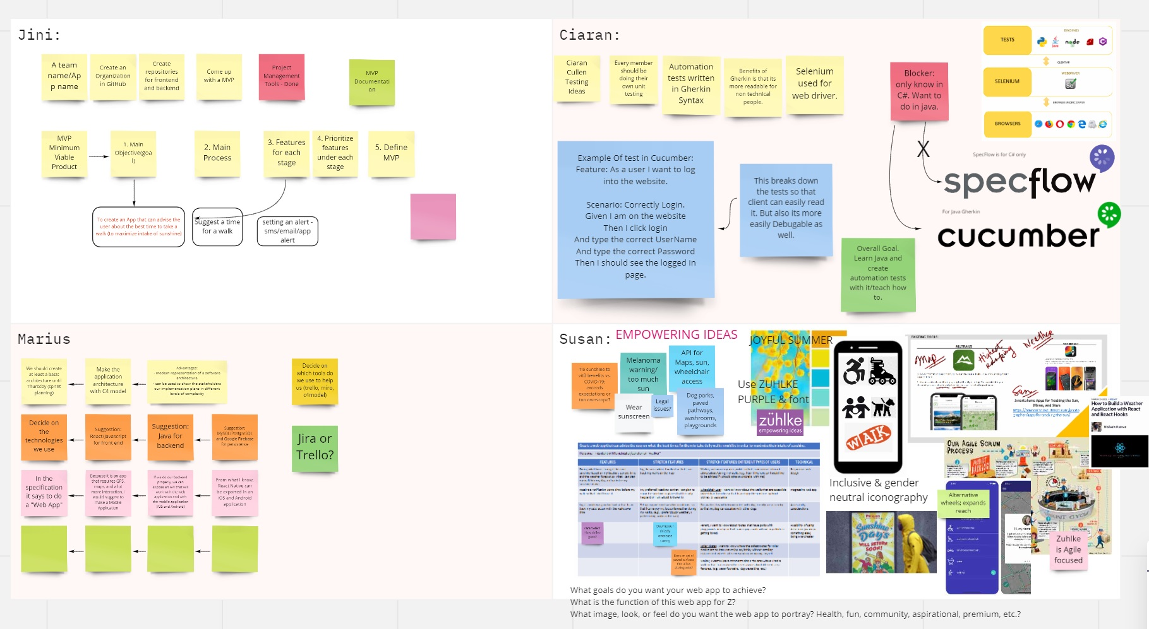

Slide 9
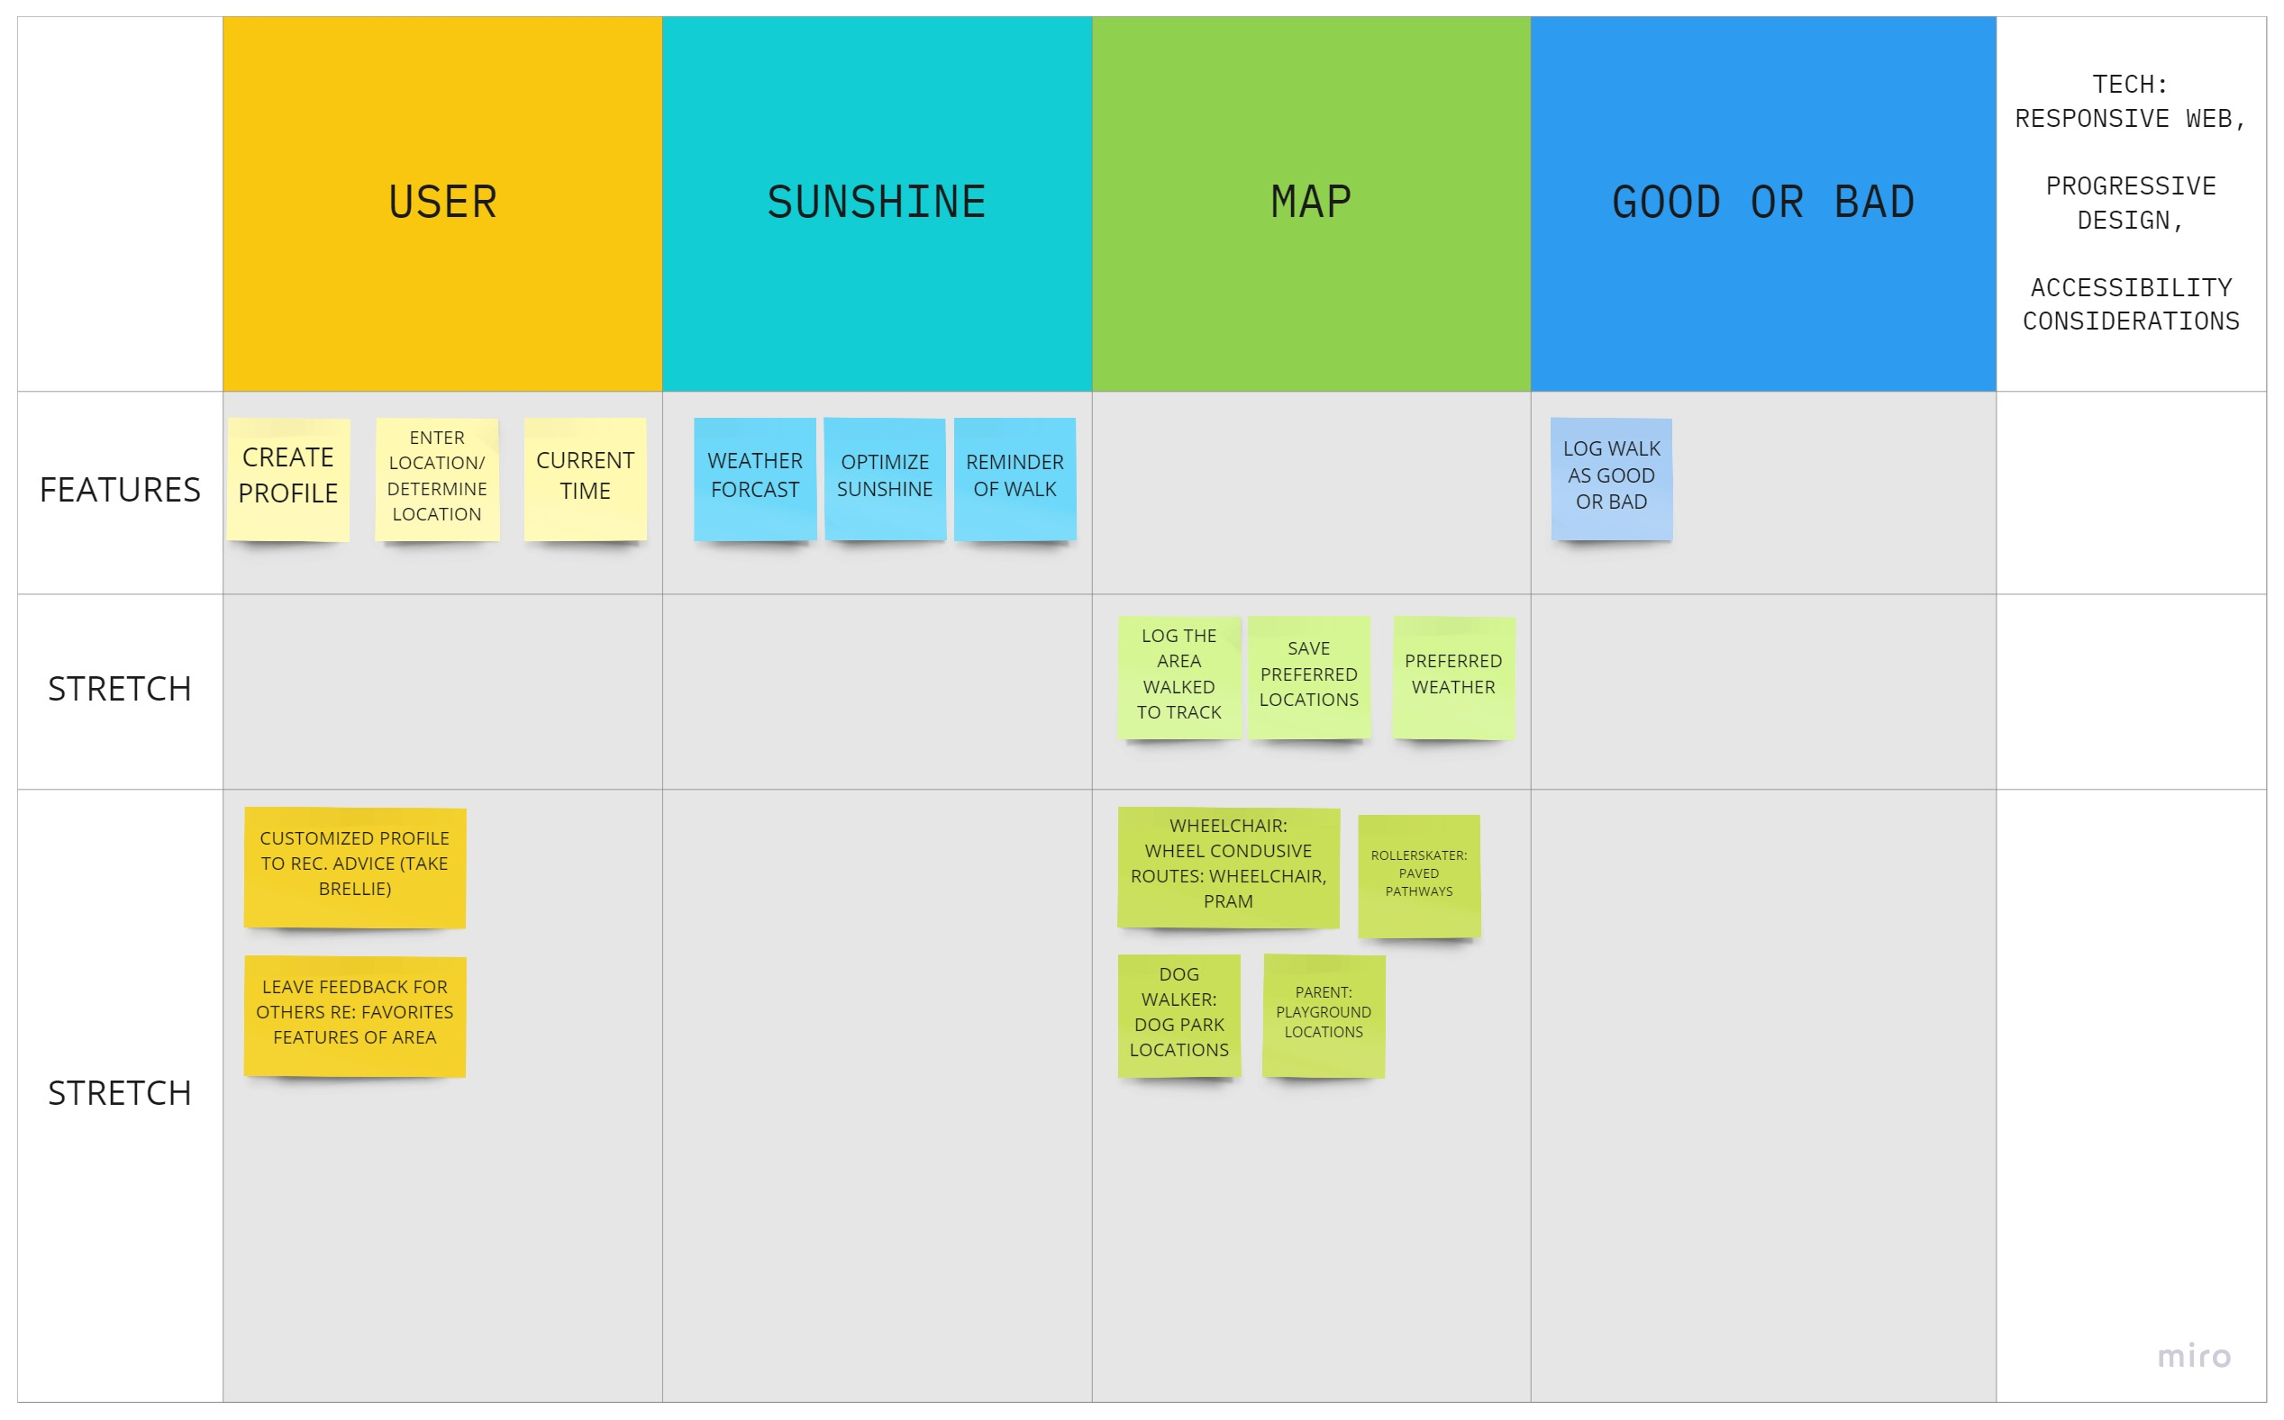
Minimum Viable Product (MVP)

Slide 10
Agile Summary
Scrum Stand Ups 3x week
Reflection 1x week (Friday)
Scrum Leader rotates weekly
Pair programming weekly
Within team and out
GitHub: Team member reviews and merge
Tools: Trello, Miro, Google Calendar

Slide 11
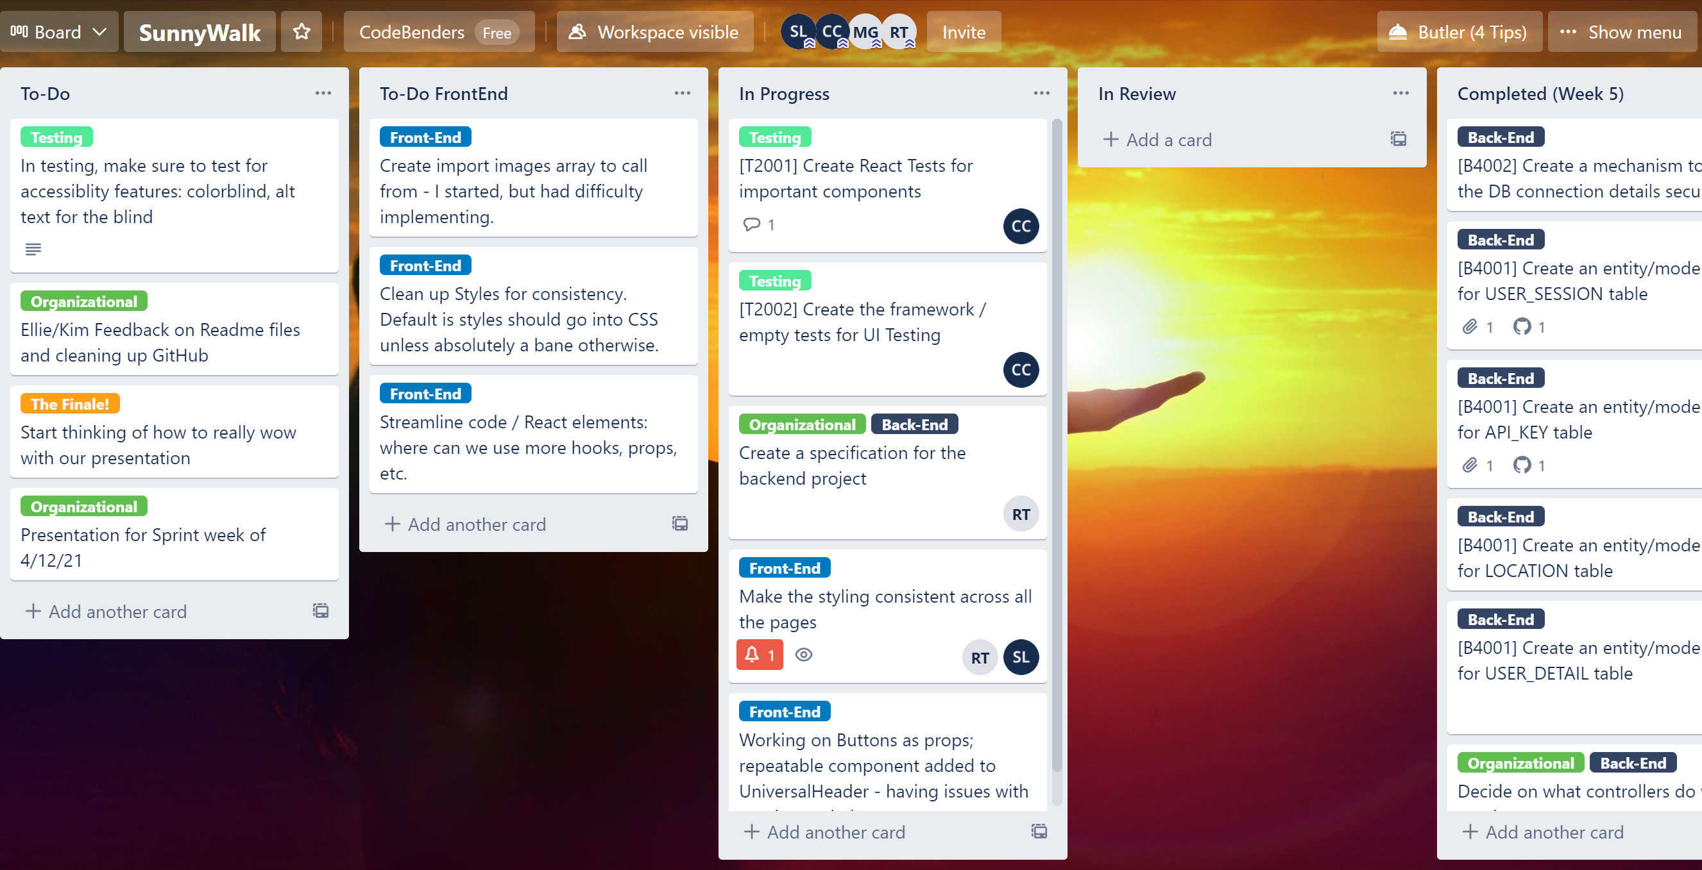
Sunny Walk Trello Board (wk of Apr 15th)

Slide 12
Frontend

Slide 13
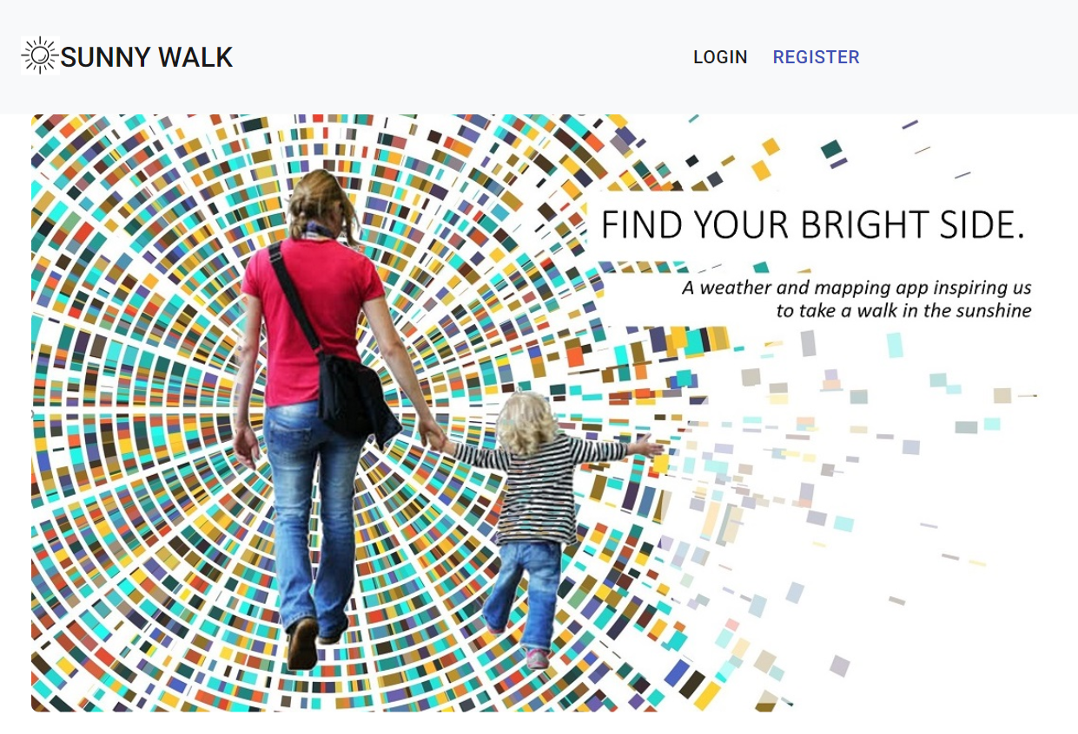
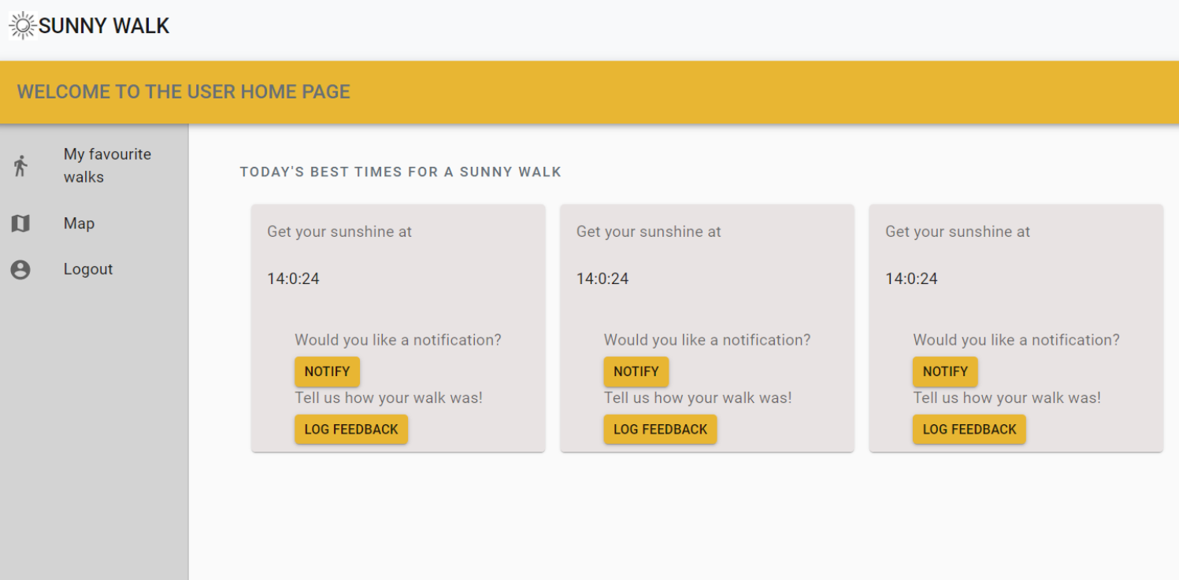
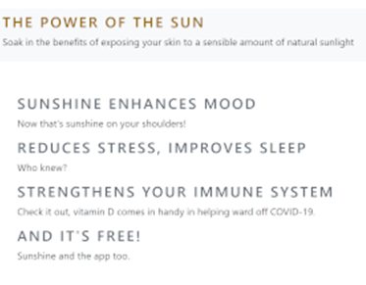
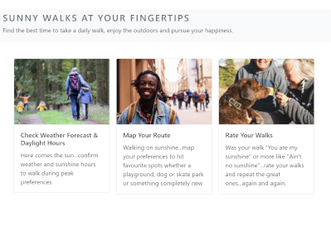
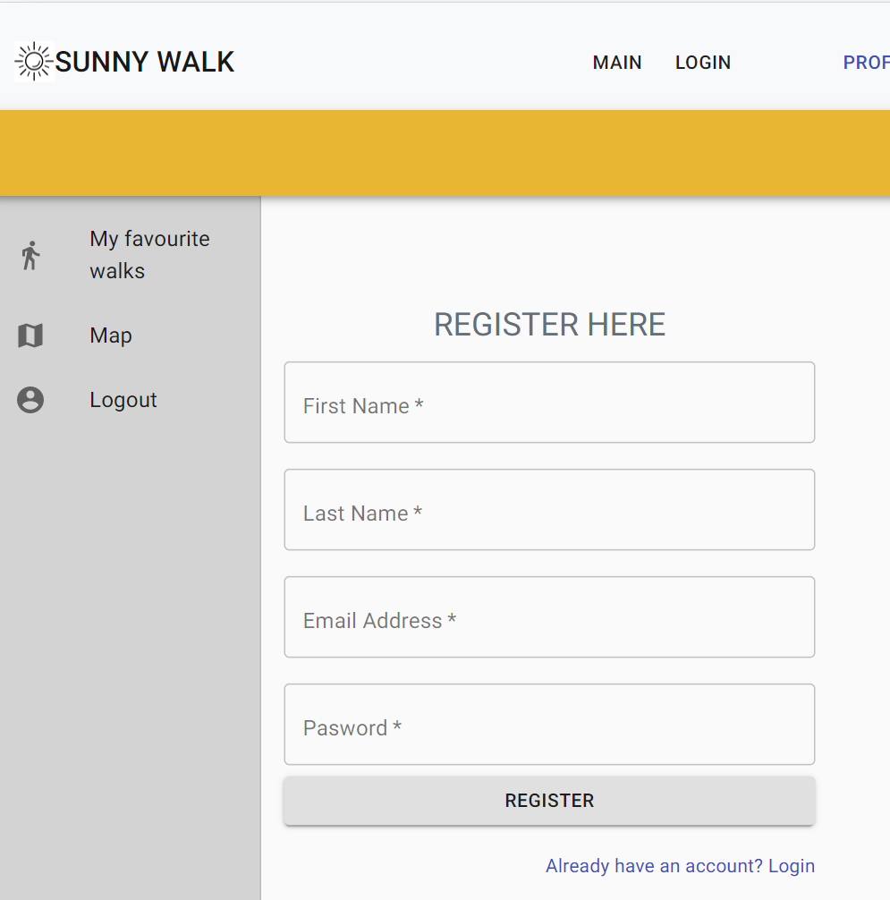
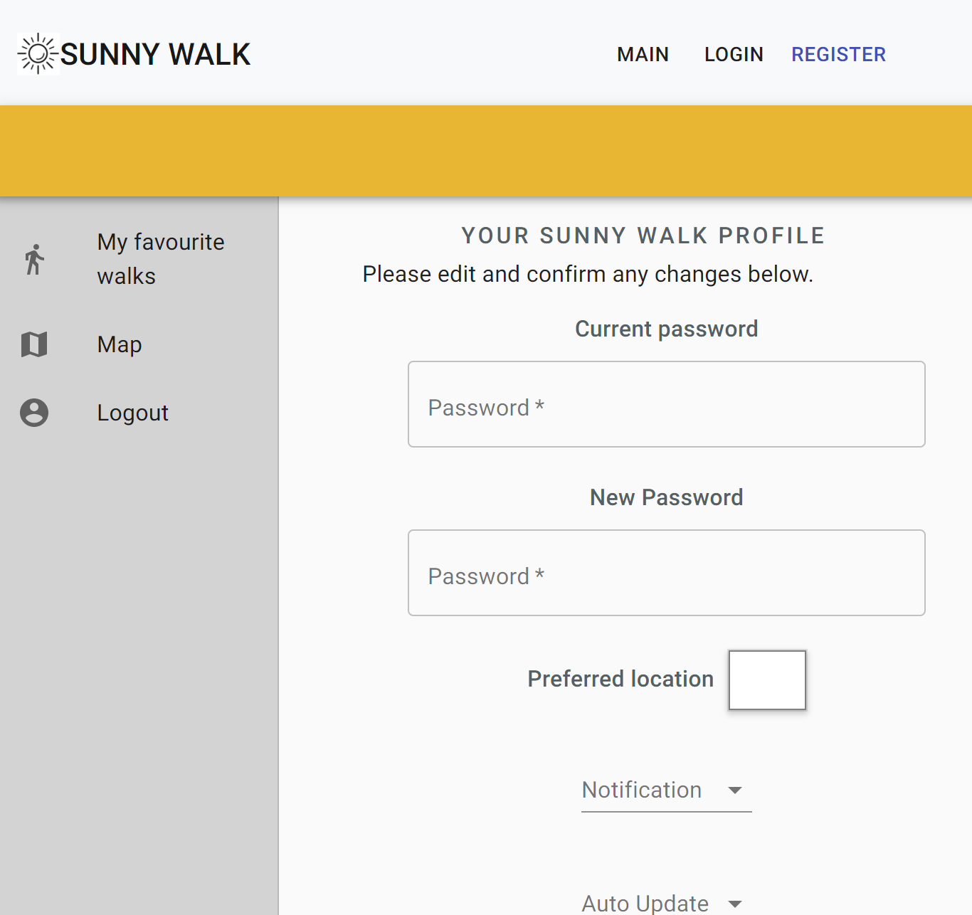
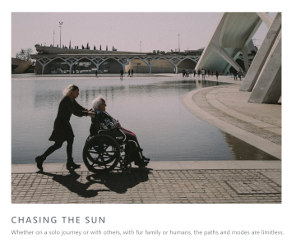
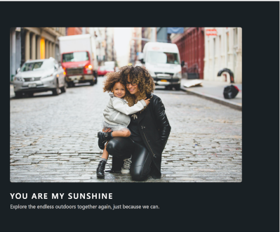
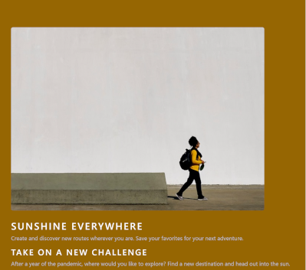
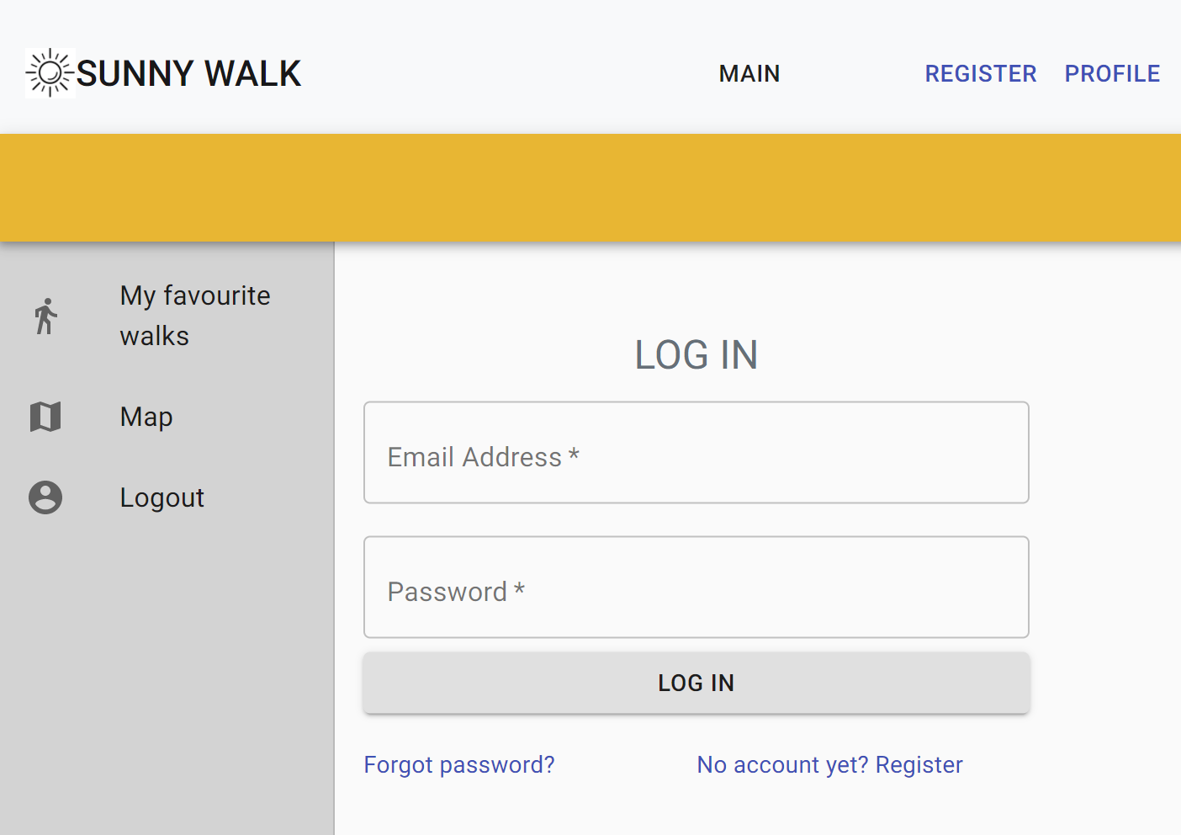
Sunny Walk Pages: Overview
Upbeat, modern design
Strong multicultural and multigenerational visuals
Fully responsive and continuity of design
Standardized & inclusive:
7 user types from active wheelchair, electronic wheelchair, push walker, pram, walking, etc.
Dwell time maximizer with 11 sunshine song titles
USER HOME
REGISTER
PROFILE
LOG IN

Slide 14
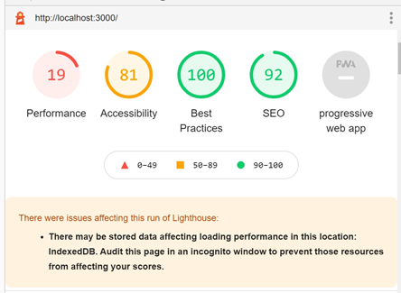
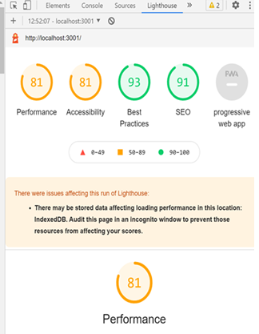
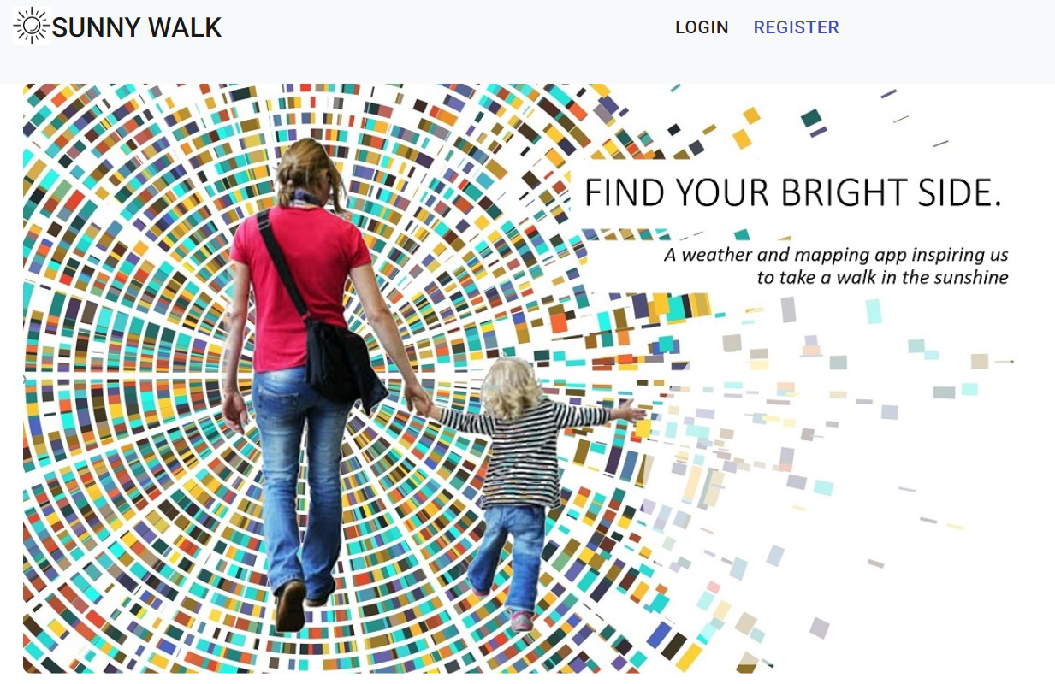
Web Performance & Accessibility Testing
ORIGINAL ASSESSMENT
Google Lighthouse DevTools
Performance Improvement: 19 to 81
Performance improvement with image preload, React loader component with placeholder images
Accessibility: 81
~Less than 1% of website homepages meet basic web accessibility standards; POUR: Perceivable, Operable, Understandable, and Robust*
Sunny Walk includes:
Alternatives to auditory and visual content
alt: “Woman of colour wearing backpack walking solo against industrial style city wall”
Accessibility: “colorblind”
Gravity: “faces”
CURRENT ASSESSMENT
Source: Ten10.com/accessibility-testing

Slide 15
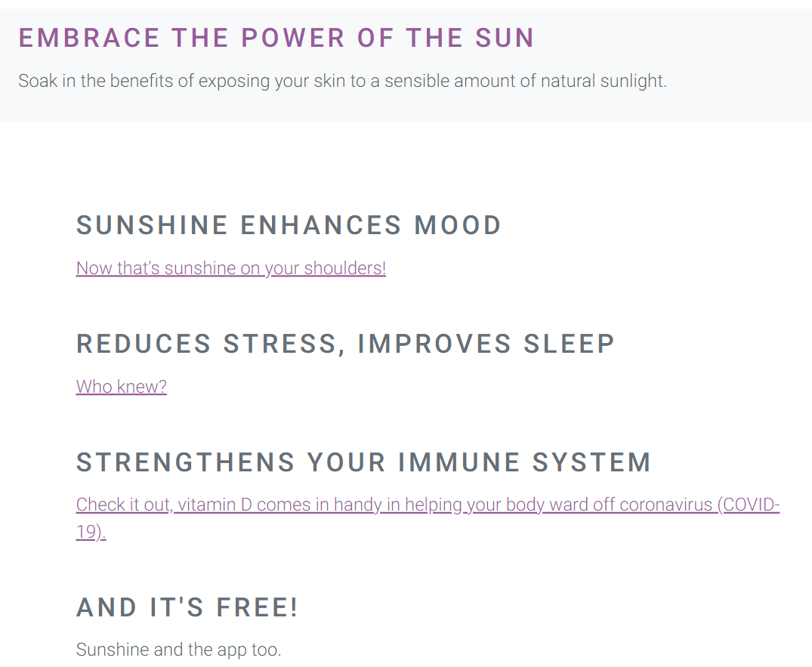

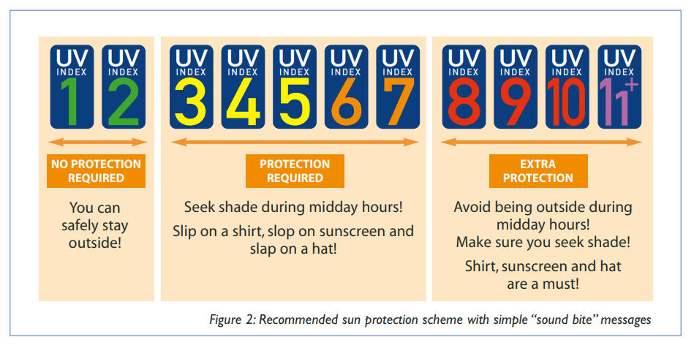
Conscientious Usability
Sunny Walk Landing Page:
Brief: Create a web app that can advise the user on the best times to take daily walks in order to maximise intake of sunshine.
Sun exposure benefits and precautions addressed
Links to globally recognized WebMD for benefits
UV Index included on User Home for weather/sunshine assessments
Sun cream reminder
Source:
https://www.who.int/uv/publications/en/UVIGuide.pdf

Slide 16
Unit Testing Integration and end to end Testing plans

Slide 17
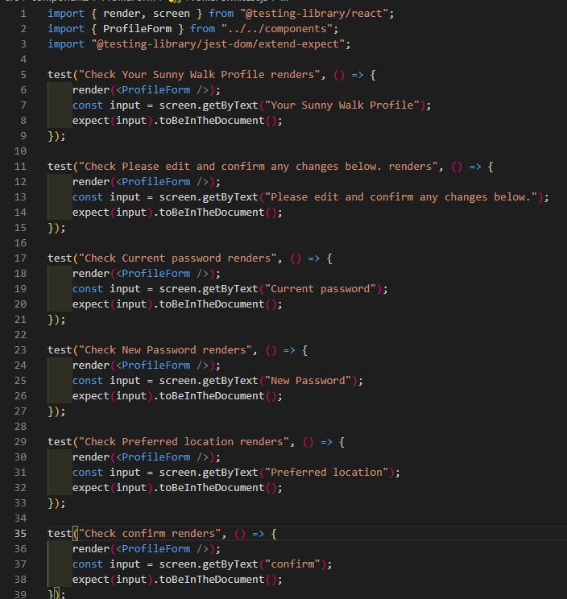
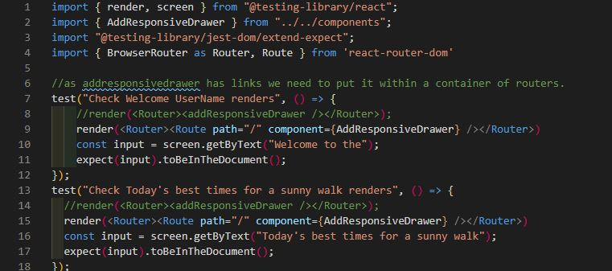
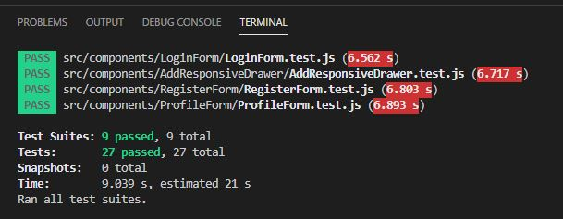
Unit Testing
All-purpose unit testing to start
Blocker with links and routers on a test components
Goal is minimum of one test per component
More complex tests to come when product is more developed

Slide 18

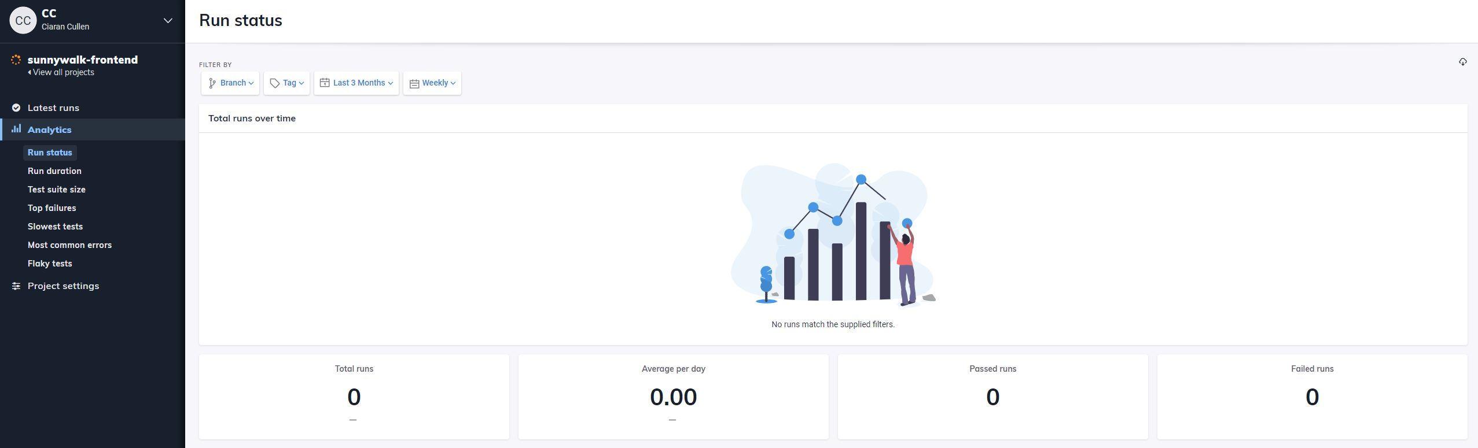


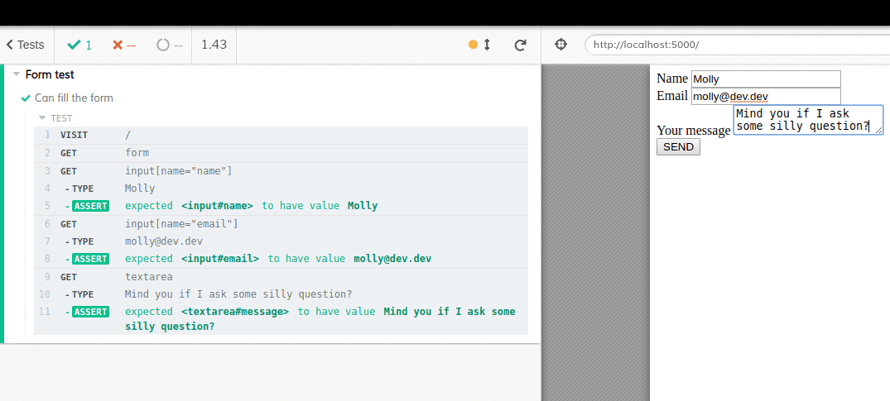
Future Testing
Easily able to record results
A lot more readable for all teams
Know selenium and Spec Flow for C# as a backup
Looking forward to learning this new technology

Slide 19
Database

Slide 20
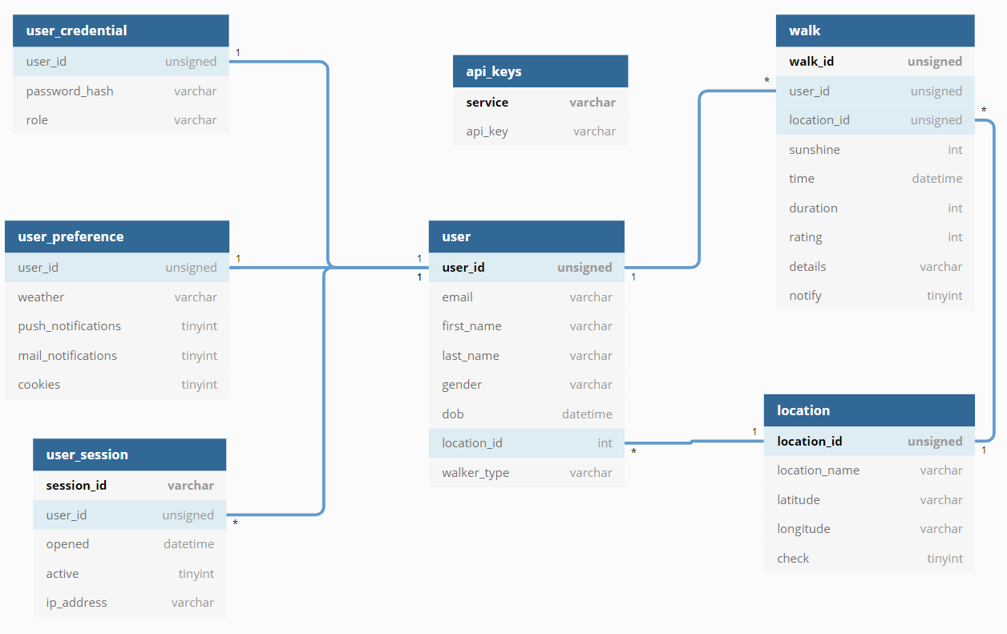
Sunny Walk DB
DB Table Design
Table(s):
For User details, Preferences and Sessions
Location details
User Walk details
Store API details used in project

Slide 21
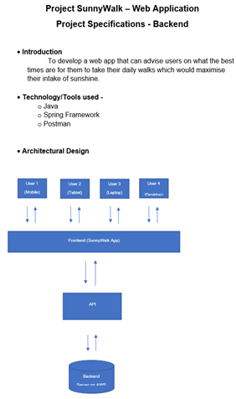
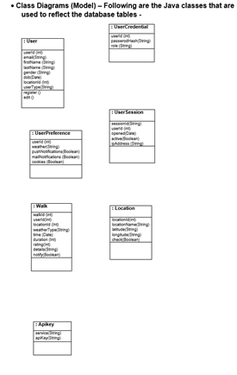
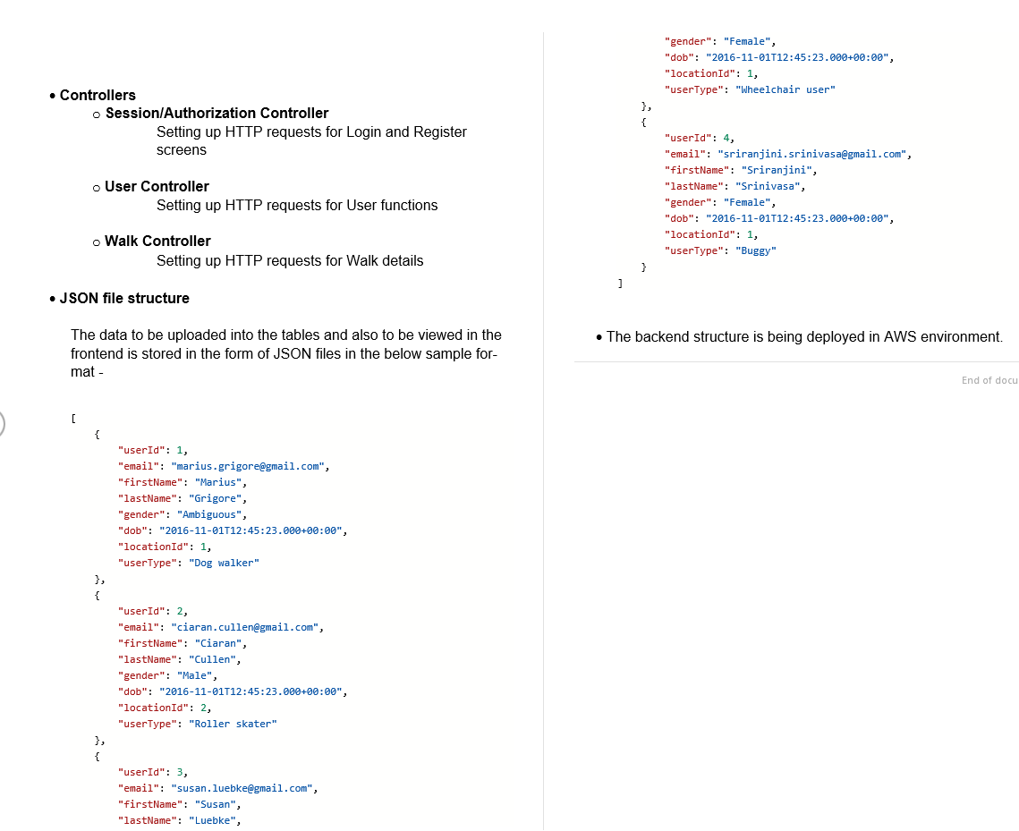
Sunny Walk Specifications & Class Diagrams
Microservice Architecture
Java class models
Controllers for Authorization, User and Walk
JSON file structure from Postman

Slide 22
Backend Tech stack: Java Spring Boot + MySQL Next steps: add functionality and test

Slide 23
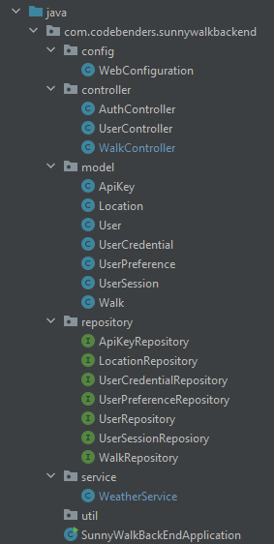
Backend Structure
Spring Boot (MVC)
MySQL driver + JPA repositories
Jackson for serialization/deserialization
OpenWeatherMap API for weather information

Slide 24
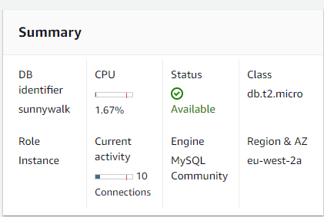
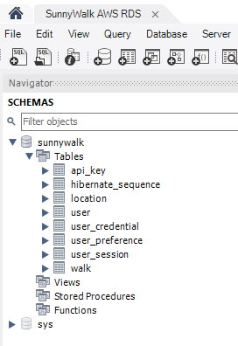
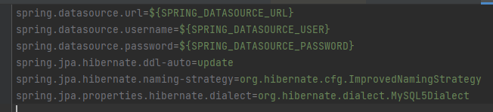
Backend Structure Continued
Database hosted on AWS (RDS)
Database editing with MySQLWorkbench
Used environment variables for connection details (security reasons)

Slide 25
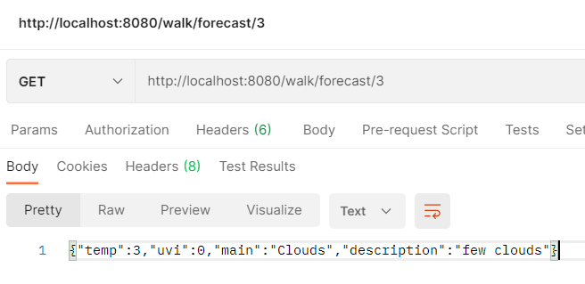
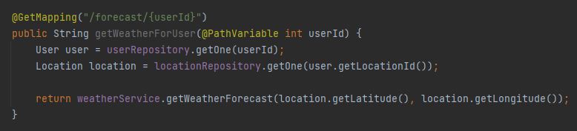
Example: Weather Forecast Controller
Example: Weather forecast controller
Temperature (Celsius)
UV Index
Main weather
Description

Slide 26
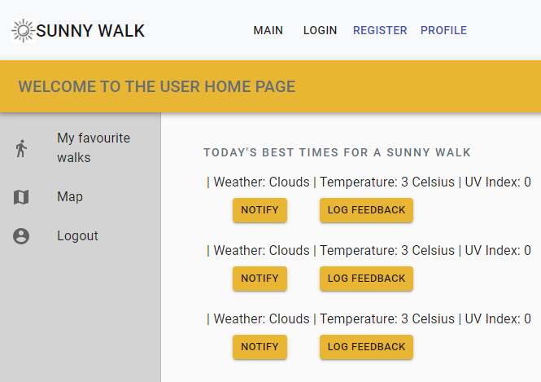
Example: Frontend Call
Front-end representation of the previous call
Axios used for serialization/deserialization

Slide 27
Feedback & Questions

